Slide 1
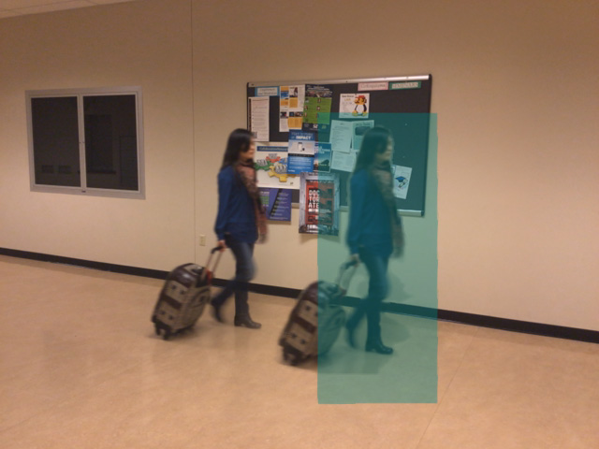



RGBD Temporal Resampling for Real-Time Occlusion Removal
Meng-Lin Wu and Voicu Popescu
Purdue University

Slide 2
Motivation
Manage occlusion in real world video acquisition

Slide 3
Motivation
Manage occlusion in real world video acquisition
Diminished reality

Slide 4
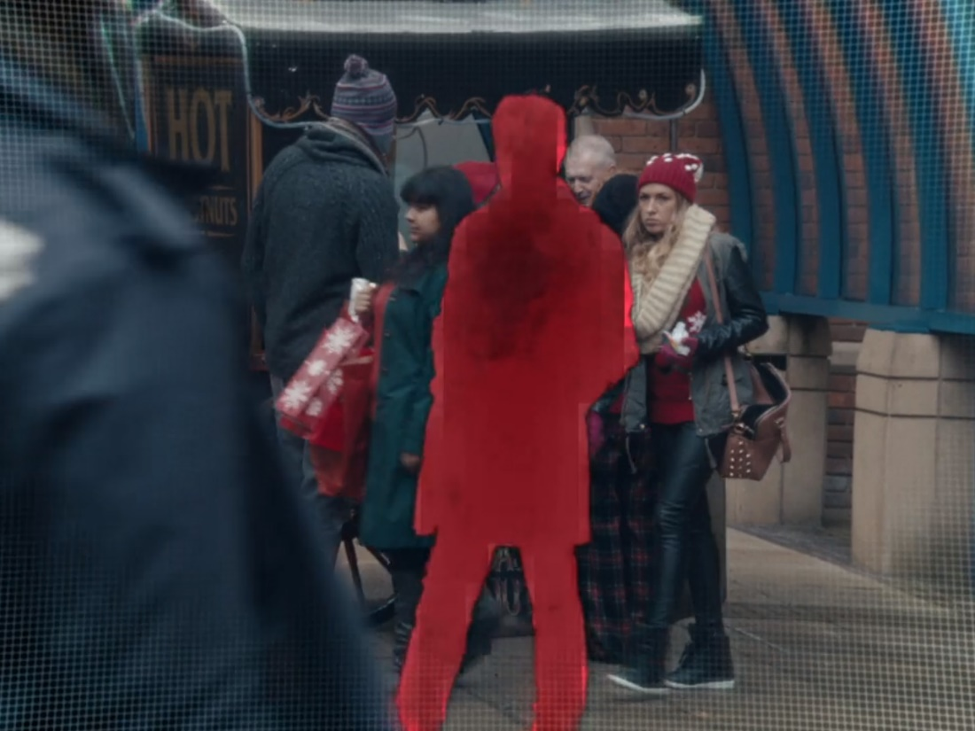
Motivation
Manage occlusion in real world video acquisition
Diminished reality
White Christmas, Black Mirror

Slide 5
Motivation
Manage occlusion in real world video acquisition
Diminished reality
Surveillance
White Christmas, Black Mirror

Slide 6
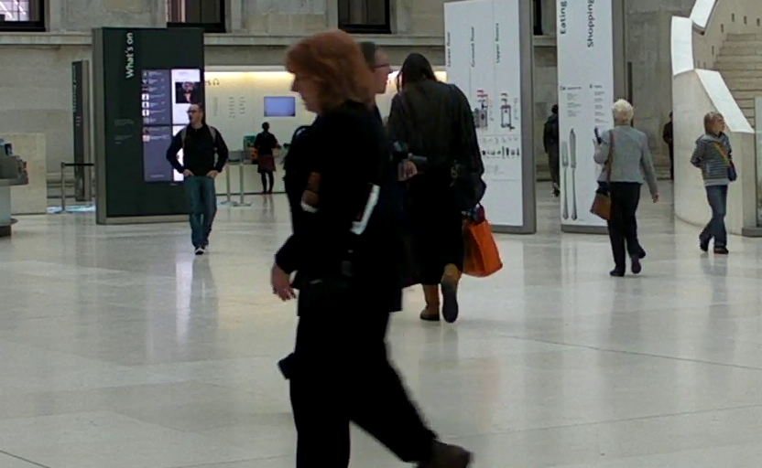
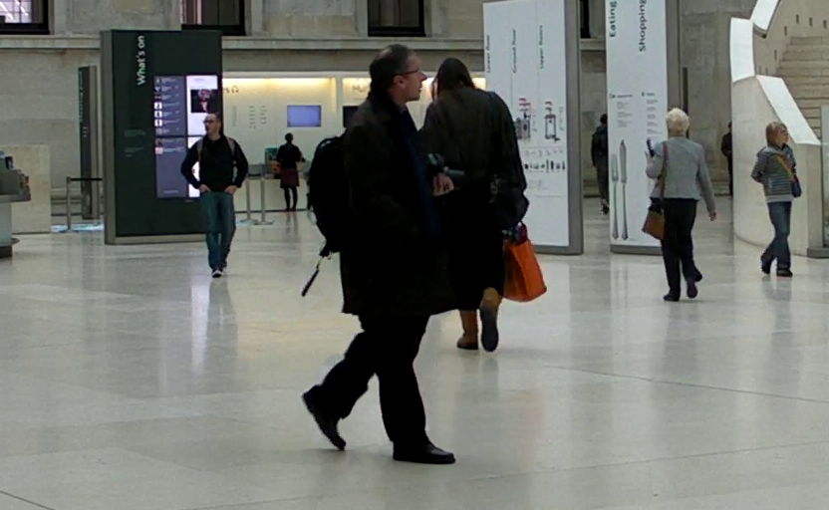
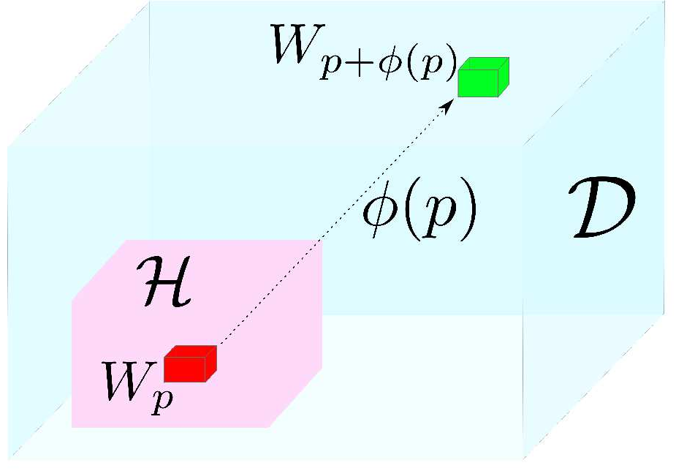
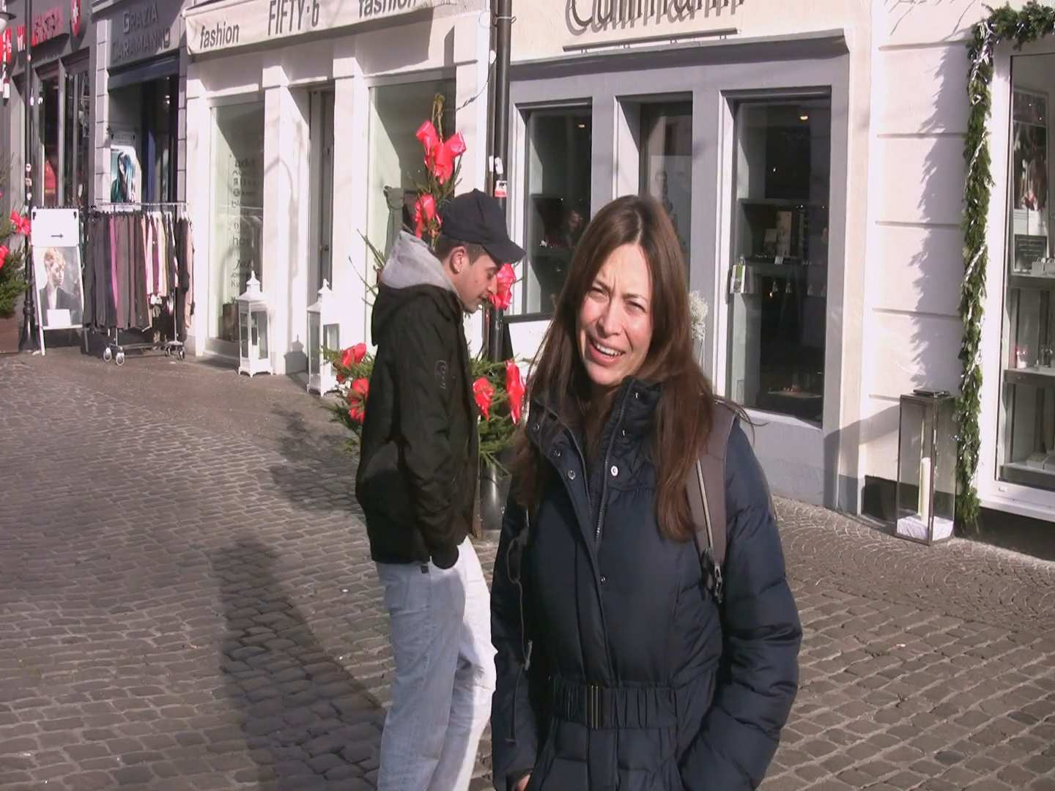
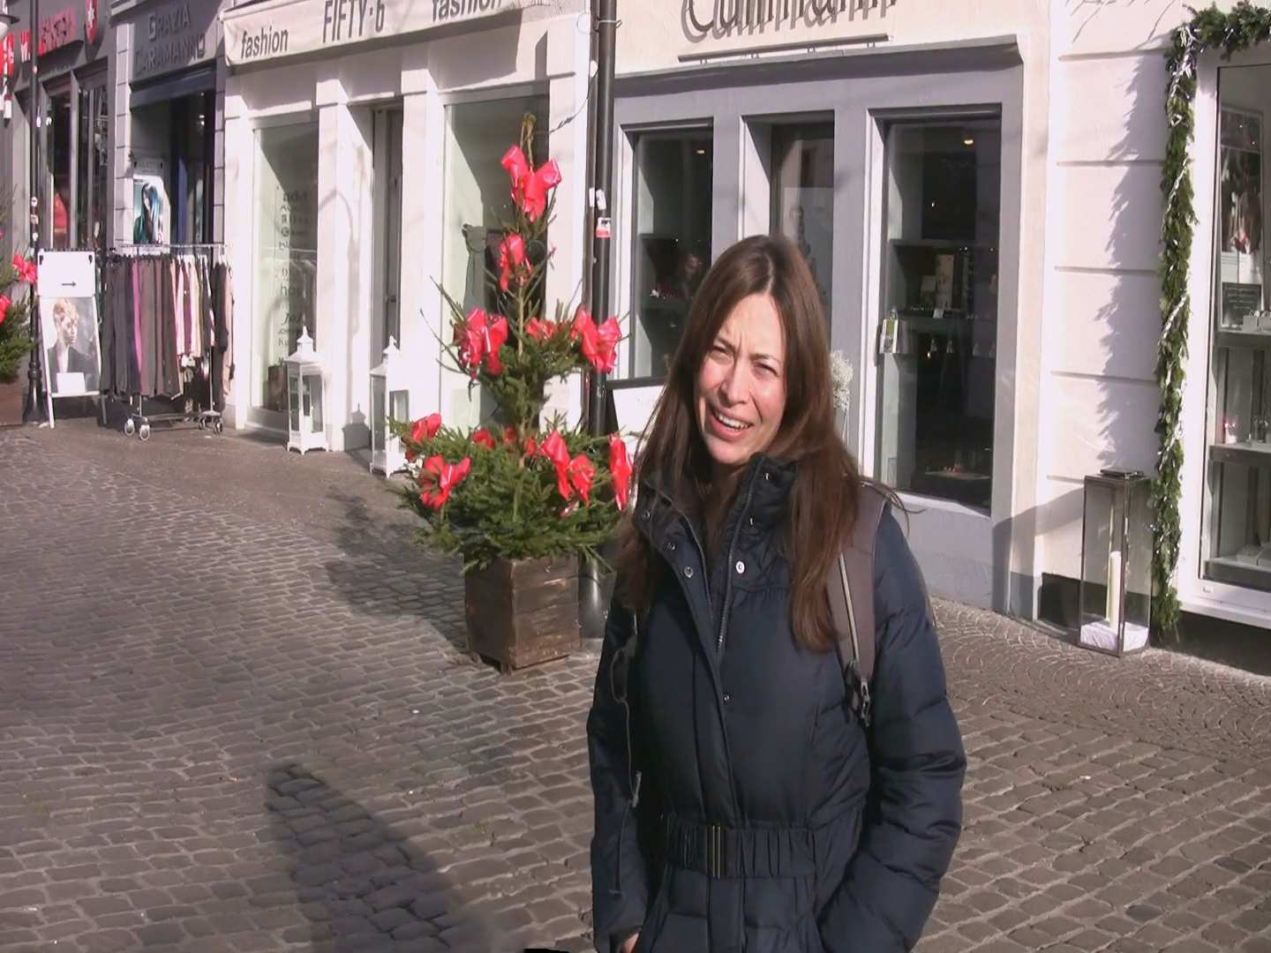
Prior work
Patch-based video inpainting
General solution
Computationally expensive
[Granados et al. 2012]
y
t
x
[Newson et al. 2014]

Slide 7
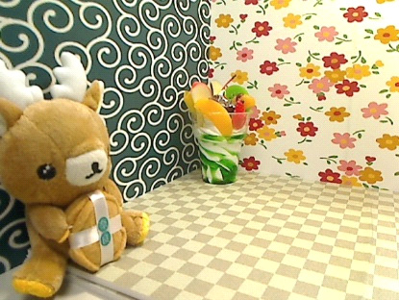
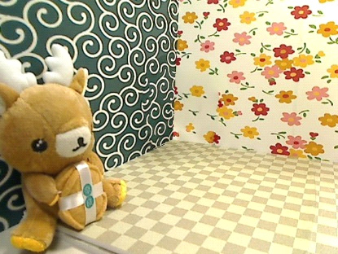
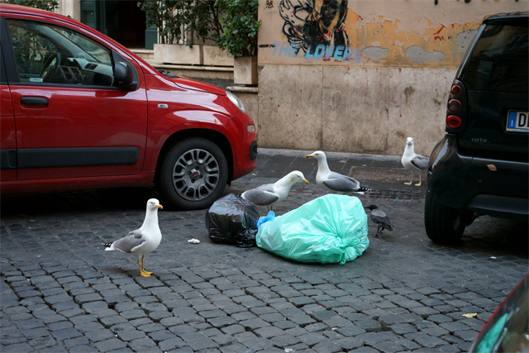
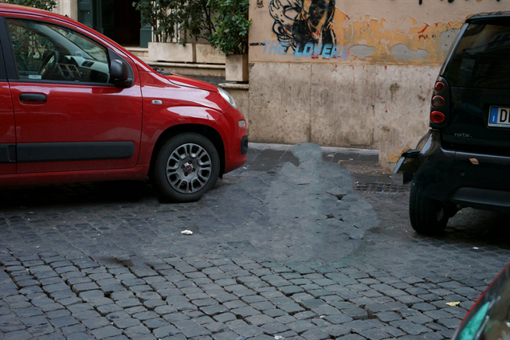
Prior work
Fast solutions with assumptions
Foreground
Static
Planar
Background
Static
Planar
Self-similar
[Kawai et al. 2016]
[Herling and Broll 2014]

Slide 8
Prior work
Fast solution
Static
Planar
Self-similar
General solution
Computationally expensive

Slide 9
Motivation
Manage occlusions in real world videos
Diminished reality
Surveillance
White Christmas, Black Mirror

Slide 10
Motivation
Manage occlusions in real world videos
Diminished reality
Surveillance
Existing video inpainting methods unsuitable
Strict scene requirements
Offline performance

Slide 11
Motivation
Manage occlusions in real world videos
Diminished reality
Surveillance
Existing video inpainting methods unsuitable
Strict scene requirements
Offline performance
Goal – remove occlusions in videos…
For general deformable dynamic foreground / background
Fast

Slide 12
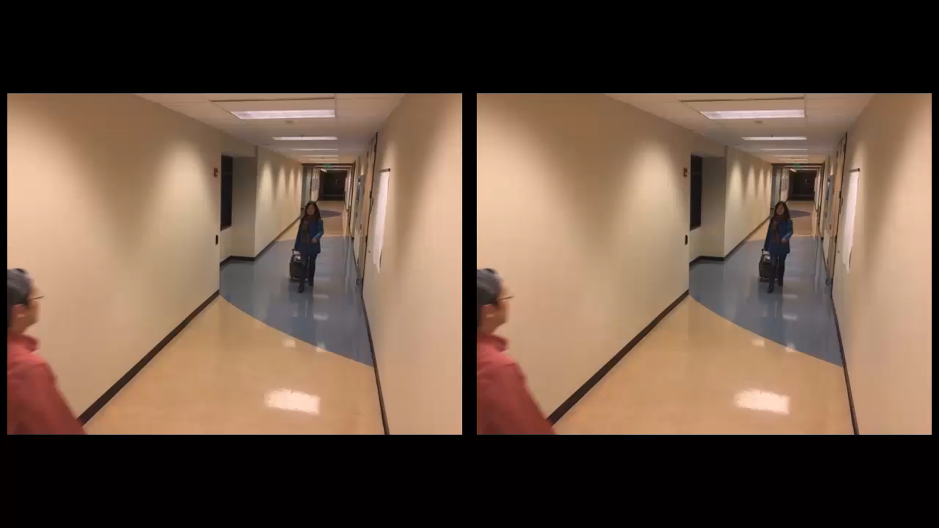
Results

Slide 13
How
How to minimize search space for resampling missing pixels?

Slide 14
How
How to minimize search space for resampling missing pixels?
Look for spatio-temporal similarity

Slide 15
How
How to minimize search space for resampling missing pixels?
Look for spatio-temporal similarity

Slide 16
How
How to minimize search space for resampling missing pixels?
Look for spatio-temporal self-similarity

Slide 17
How
How to minimize search space for resampling missing pixels?
Look for spatio-temporal self-similarity
For the target object as a whole

Slide 18
How
How to minimize search space for resampling missing pixels?
Look for spatio-temporal self-similarity
For the target object as a whole
Assumptions:
Target doesn’t change appearance drastically
Target doesn’t merge or disintegrate

Slide 19
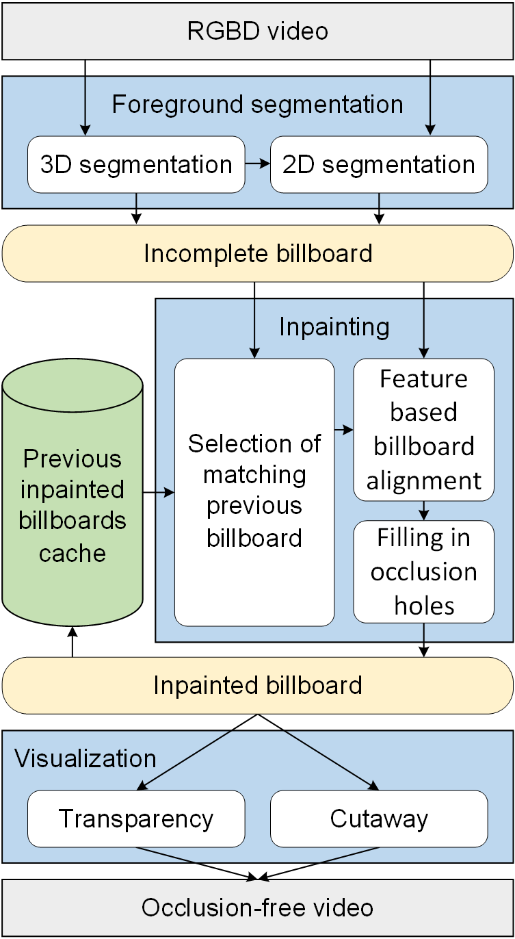
System overview
Pipeline
Segment objects
Retrieve best match from cache
Reconstruct target
Visualize scene

Slide 20
System overview
Pipeline
Segment objects
Retrieve best match from cache
Reconstruct target
Visualize scene
Leverage depth from RGBD streams
Fast segmentation
Fast matching + alignment

Slide 21
Segmentation

Slide 22
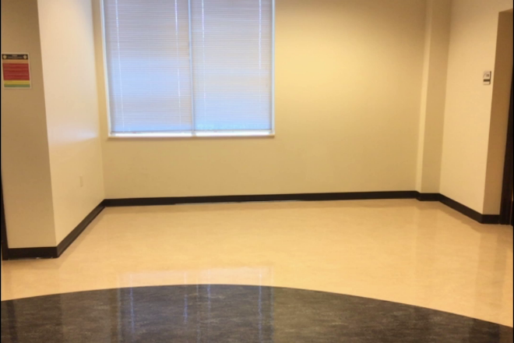
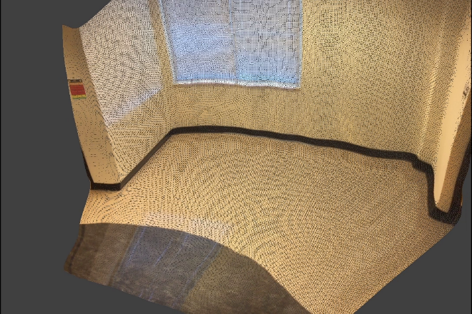
Segmentation
0) static background

Slide 23
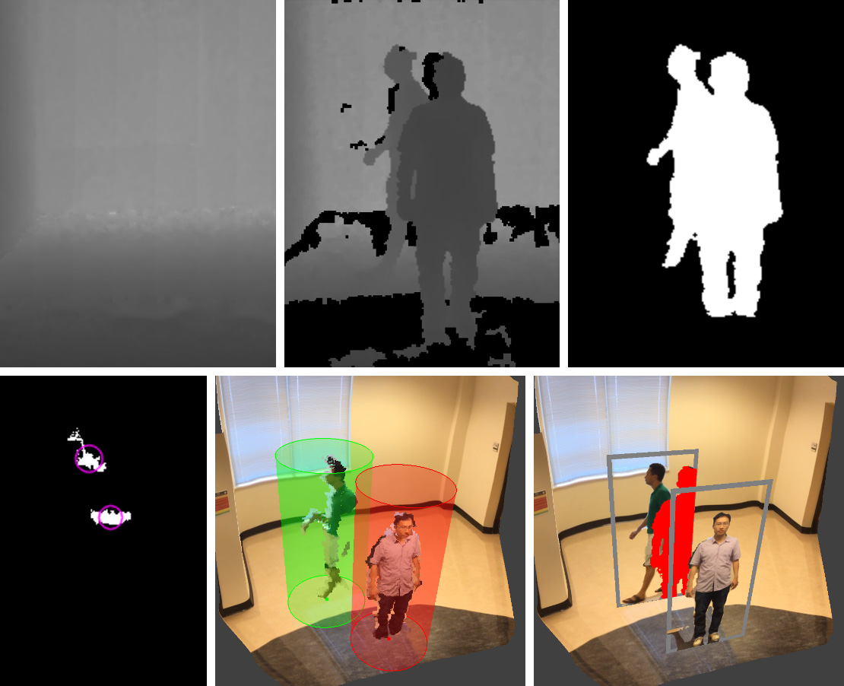
Segmentation
0) static background
1)~3) 2D segmentation
suppress static background
4) top view of foreground objects
clustering / tracking
5) bounding cylinders
6) impostor billboards
1
2
3
4
5
6

Slide 24
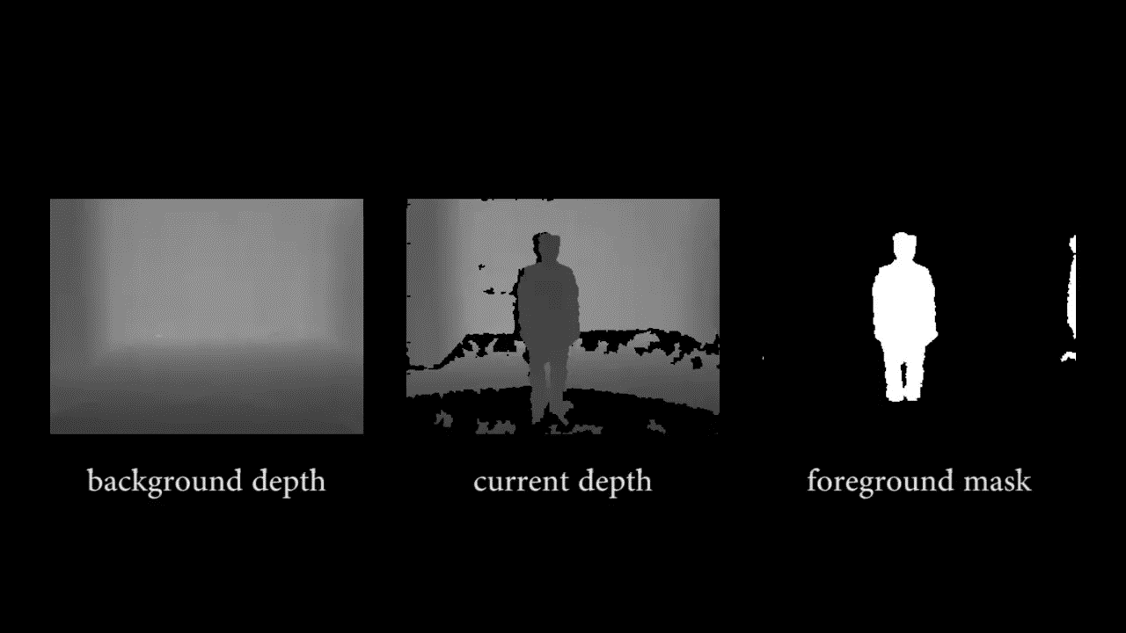
Segmentation
0) static background
1)~3) 2D segmentation
suppress static background
4) top view of foreground objects
clustering / tracking
5) bounding cylinders
6) impostor billboards

Slide 25
Impostor billboard matching

Slide 26
Impostor billboard matching

Slide 27
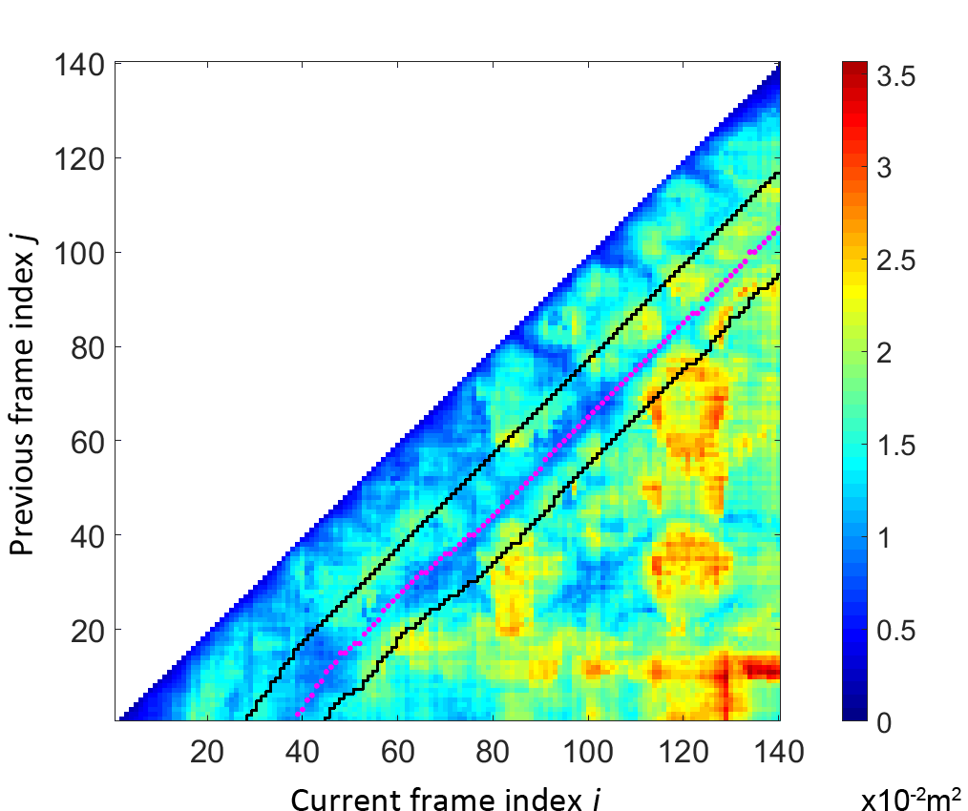
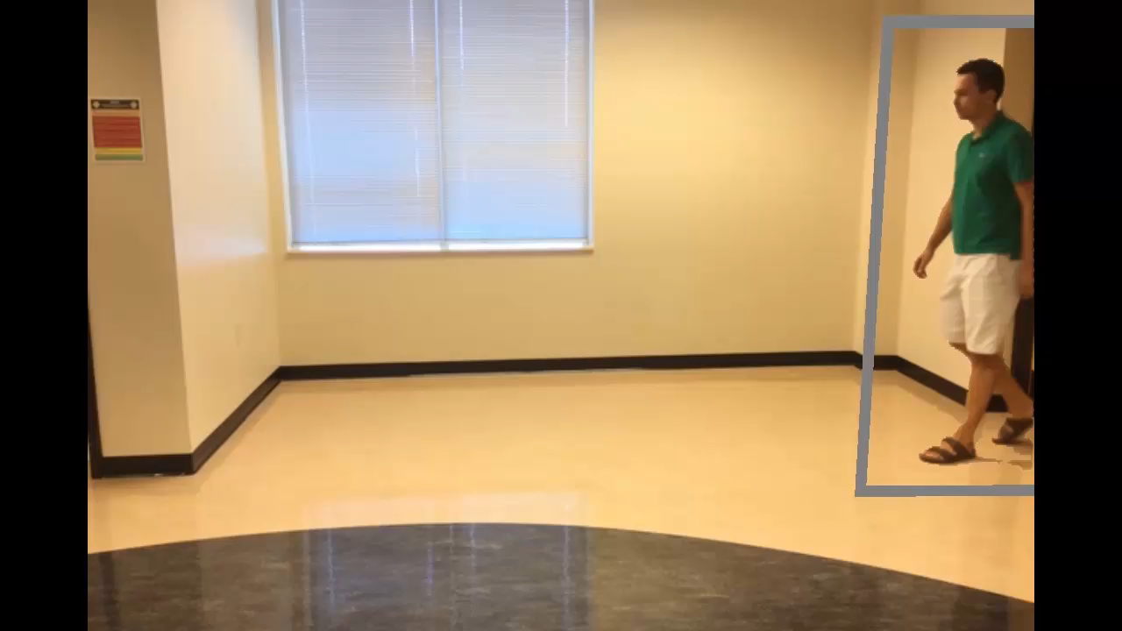
Impostor billboard matching
distance between depth images -
previous frame vs current frame

Slide 28
Impostor billboard matching

Slide 29
Impostor billboard matching

Slide 30
Impostor billboard matching

Slide 31
Impostor billboard matching

Slide 32
Reconstruction

Slide 33
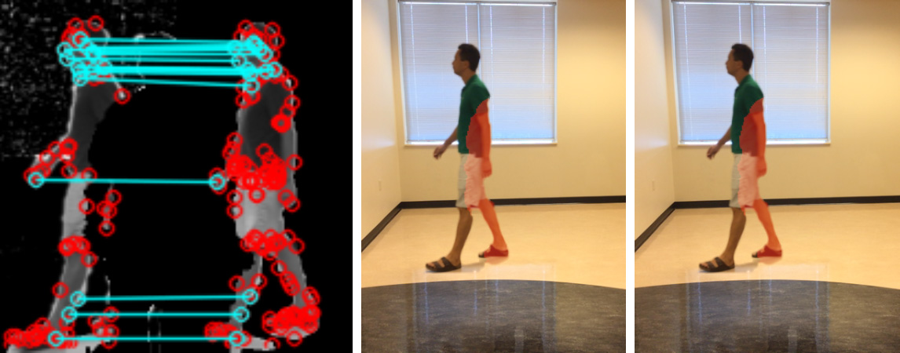
Reconstruction
Feature extraction and matching
Before feature-based morph
After feature-based morph

Slide 34
Reconstruction

Slide 35
Reconstruction

Slide 36
Visualization

Slide 37
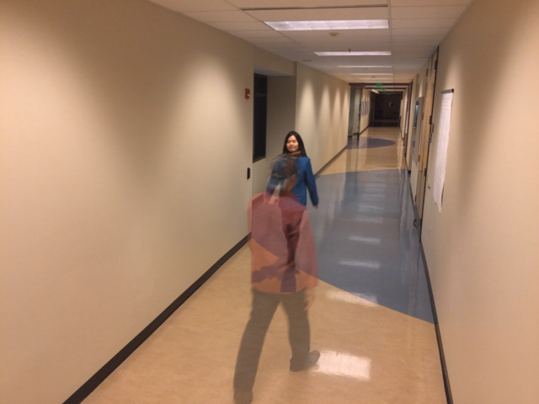
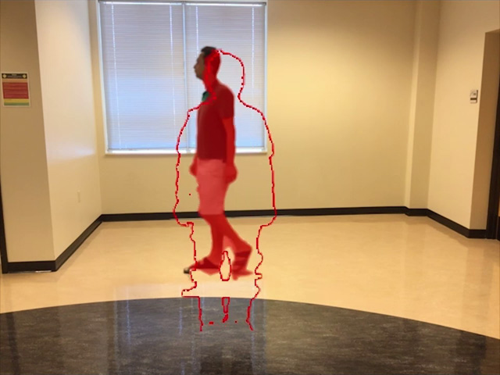
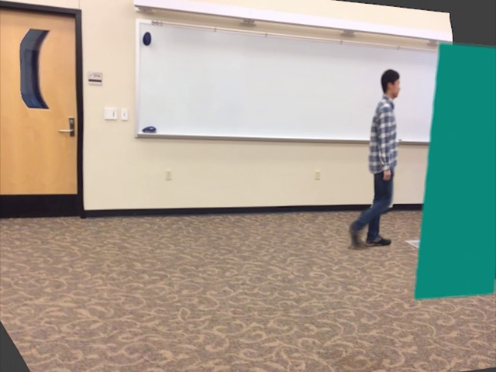
Visualization
The occluder is transparent
The occluder is shown as silhouette
Free-viewpoint video:
The camera is shifted to avoid occlusion

Slide 38
Results

Slide 39
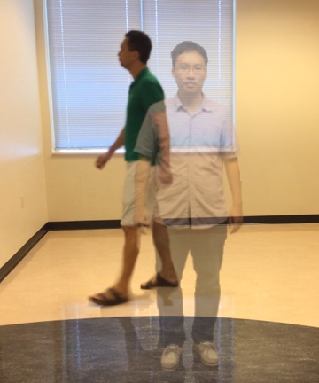
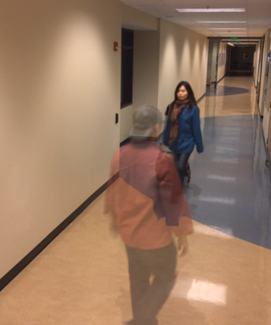
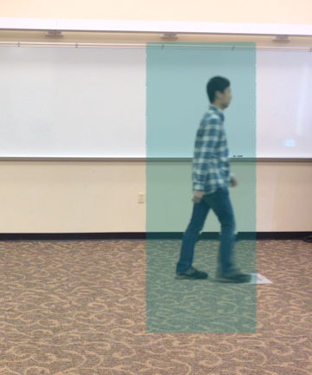
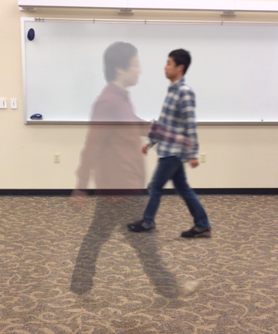
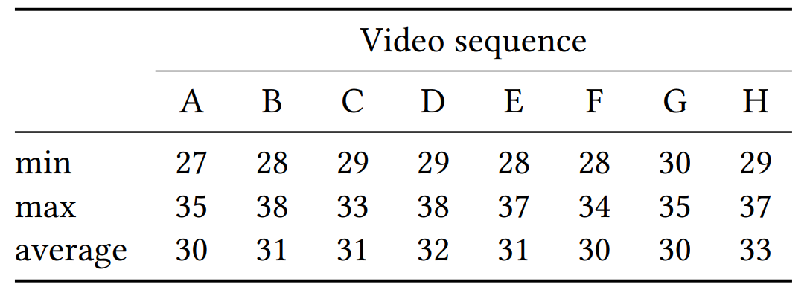
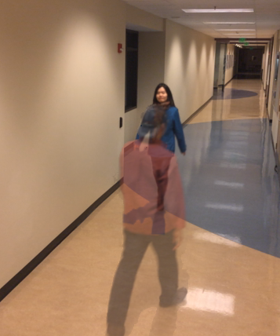
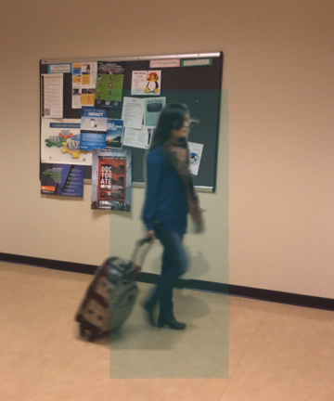
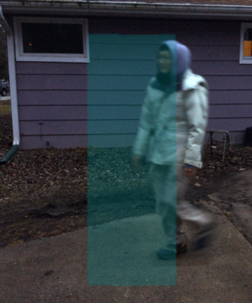
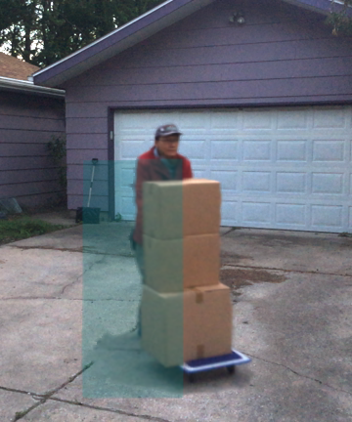
Performance
Frame rates achieved by our method [fps].
A
B
C
D
E
F
G
H

Slide 40
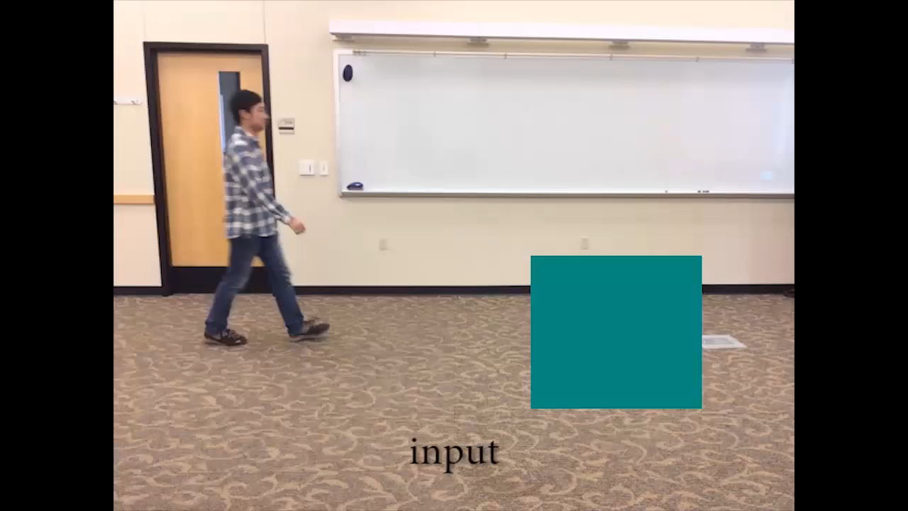
Comparison with prior work*
* “Video Inpainting of Complex Scenes,” A. Newson, A. Almansa, M. Fradet, Y. Gousseau, and P. Pérez, SIAM Journal on Imaging Sciences, 7(4), 2014

Slide 41
Quality comparison
Compare output against ground truth

Slide 42
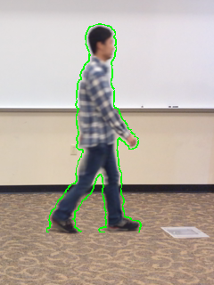
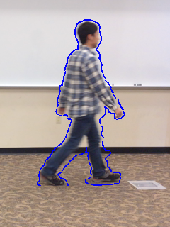
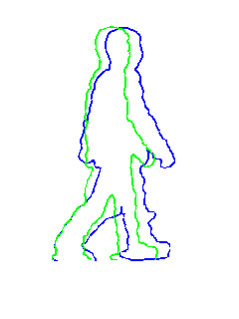
Quality comparison
Compare output against ground truth
Conventional image difference metrics not useful
output
ground truth
overlay

Slide 43
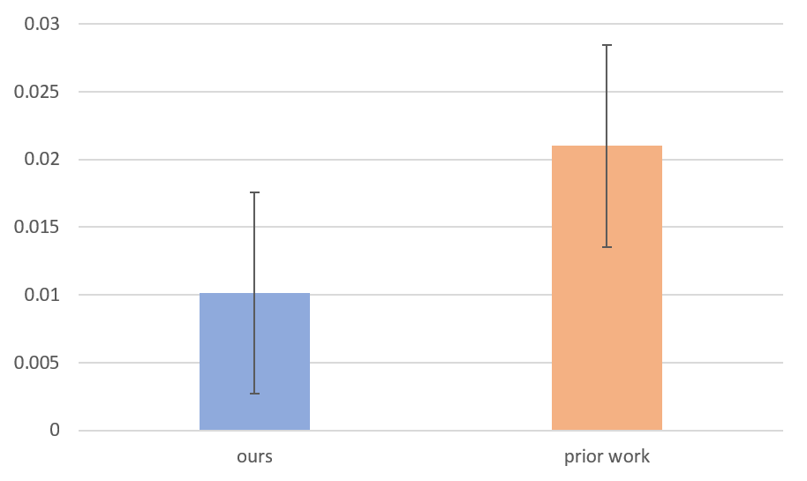
Quality comparison
Use CNN-based image features
The Unreasonable Effectiveness of Deep Features as a Perceptual Metric [Zhang et al. 2018]
Convolutional layers from AlexNet [Krizhevsky et al. 2012]
ours
0.010±0.007
prior work
0.021±0.007
average cosine distance from ground truth

Slide 44
Summary
Our algorithm…
Inpaints videos at 30 fps
1 new frame at a time - no peaking into future
Makes more reasonable assumptions
static, planar, spatially self-similar

Slide 45
Summary
Our algorithm…
Inpaints videos at 30 fps
1 new frame at a time - no peaking into future
Makes more reasonable assumptions
static, planar, spatially self-similar
temporally self-similar, doesn’t blow up or teleport

Slide 46
Summary
Our algorithm…
Inpaints videos at 30 fps
1 new frame at a time - no peaking into future
Makes more reasonable assumptions
static, planar, spatially self-similar
temporally self-similar, doesn’t blow up or teleport
Leverage depth information
Segmentation
Impostor matching
Reconstruct approx. 3D scene

Slide 47
The thank you slide
Thank you!

Slide 48
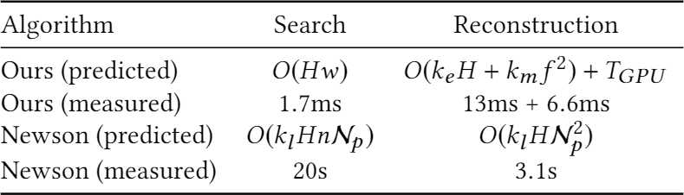
Performance comparison
N_{p}: patch size
H: hole size
n: number of source patch candidates
w: search window width
k_{l}: optimization iterations
k_{e}: feature extraction constant factor
k_{m}: feature matching constant factor

